Slide 1
Office 365 – Understanding Simple Migrations: IMAP, Cutover, and Staged
Daniel Kenyon-Smith
Microsoft Consultancy Services
UK

Slide 2
Simple Migrations – overview, capabilities, limitations, available tools
IMAP Migration
Cutover Exchange Migration (CEM)
Staged Exchange Migration (SEM)
AGENDA

Slide 3
Summary of migration options*
IMAP migration
  Supports wide range of email platforms
  Email only (no calendar, contacts, or tasks)
Cutover Exchange migration (CEM)
  Good for fast, cutover migrations
  No migration tool or computer required on-premises
Staged Exchange migration (SEM)
  No migration tool or computer required on-premises
  Requires Directory Synchronization with on-premises AD
 | IMAP migration | Cutover migration | Staged migration | 2010 hybrid | 2013 hybrid
Exchange 5.5 | ■
Exchange 2000 | ■
Exchange 2003 | ■ | ■ | ■ | ■
Exchange 2007 | ■ | ■ | ■ | ■ | ■
Exchange 2010 | ■ | ■ |  | ■ | ■
Exchange 2013 | ■ | ■ |  |  | ■
Notes/Domino | ■
GroupWise | ■
Other | ■
Simple migrations
Hybrid deployment
  Manage users on-premises and online
  Enables cross-premises calendaring, smooth migration, and easy off-boarding
Hybrid
*Additional options available with tools from migration partners

Slide 4
Additional onboarding options
Control | Deployment Type | Description
User driven | New mailbox | User receives new “green field” mailbox – i.e. user is onboarded to without data migration.
 | New mailbox + Outlook PST | User receives new mailbox and either attaches or imports PST files for access to pre-Office 365 data.
 | New mailbox + connected accounts | User receives new mailbox and configures connected accounts via OWA.
Admin driven | New mailbox + PST Import | User receives a new mailbox and admin uses the PST Capture Tool to import PST data into the user’s Exchange Online mailbox.

Slide 5

Migration option decision factors
Coexistence
requirement
Provisioning
Size
Simple
Rich
DirSync
Manual/Bulk Provisioning
Automatic Provisioning
Large
Medium
Small
Source server
DEPLOYMENT PLAN
Migration solution is part of the plan
Identity management
Exchange
IMAP
Lotus Notes
Google
On-premises
Single sign-on
On-cloud
5 | Microsoft Confidential

Slide 6
DirSync’s role in migrations:
Enables coexistence
  Provisions objects in Office 365 with same email addresses as the objects in the
  on-premises environment
  Provides a unified Global Address List experience between on-premises
  and Office 365
    Objects hidden from the GAL on-premises are also hidden from the GAL
    in Office 365
  Enables coexistence for Exchange
    Works in both simple and hybrid deployment scenarios
  Enabler for mail routing between on-premises and Office 365 with a shared
  domain namespace

Slide 7
Simple coexistence deployment
Uses Directory Synchronization for GAL synchronization
  Enabler for mail routing between on-premises and Office 365 using a shared
  DNS namespace
  Provides a unified GAL experience
Can be used with cloud identities or federated identities
Does not require an on-premises Hybrid server

Slide 8
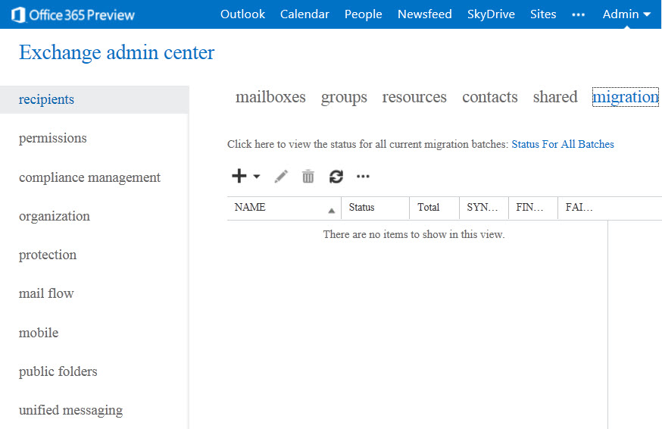
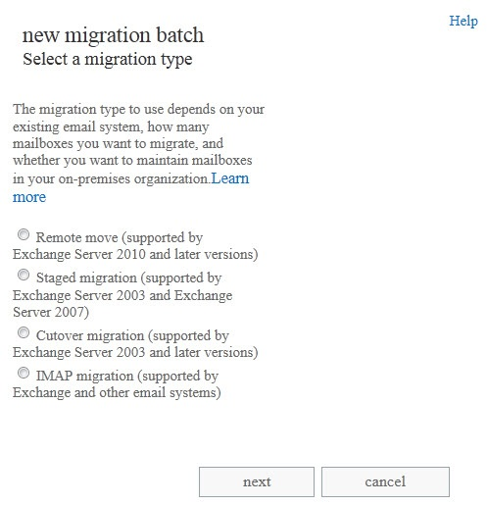
  In EAC, select
  recipients | migration
Migration Tool
launched from
Exchange Admin Center (EAC)
  Start migration wizard
  Choose migration type and follow prompts

Slide 9
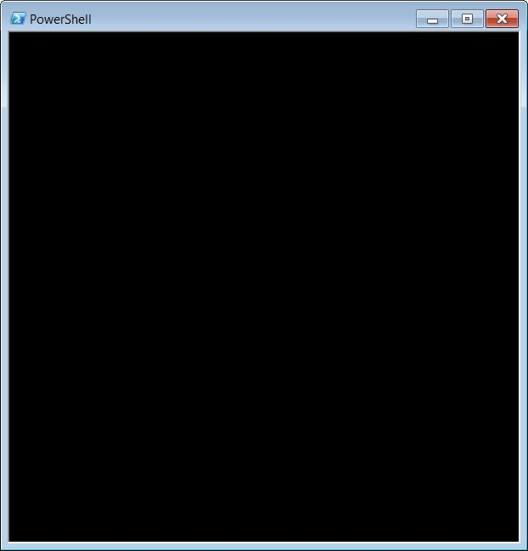
  Set of Migration Cmdlets
New-MigrationBatch
Start-MigrationBatch
Get-MigrationBatch
Get-MigrationStatus
Complete-Migration
Test-MigrationServerAvailability
Migration Tool
also available via PowerShell

Slide 10


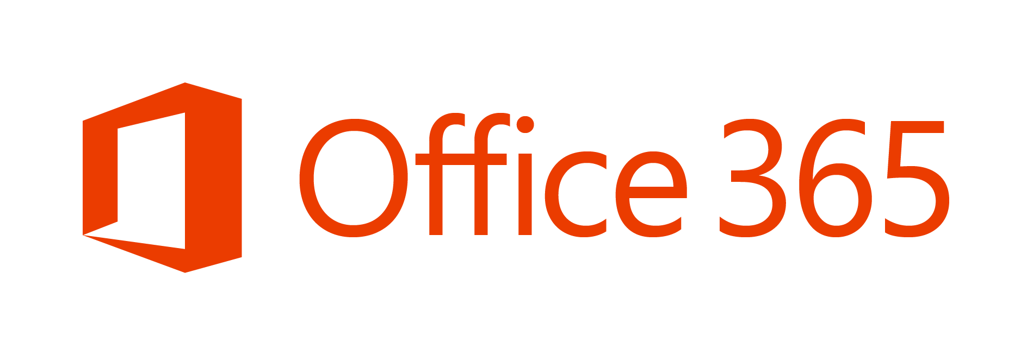
IMAP MIGRATIONS
Notes:
http://help.outlook.com/en-us/140/ms.exch.ecp.emailmigrationwizardimaplearnmore.aspx

Slide 11
IMAP – Features and Benefits
Works with a large number of source mail systems
Works with on-premises or hosted systems
Users can be migrated in batches
On-premises migration tool is not required

Slide 12
IMAP – Requirements and Limitations
On-premises migration tool is not required
Access to IMAP ports (TCP/143/993)
Users + mailboxes must be provisioned prior to migration
  Bulk provisioning, CSV parser, manual, etc.
SMTP domains configured in O365 tenant
Gather user credentials or setup admin credentials
Prepare a CSV file with list of users
  EmailAddress, UserName, Password
  Max of 50,000 rows
  Max 10 MB in size

Slide 13
IMAP – Data Migration Scope
Migrated
Mail messages
(Inbox and other folders)
Maximum of 500,000 items
Possible to exclude specific folders from migration
(e.g. Deleted Items, Junk E-Mail)
Not Migrated
Contacts, Calendars, Tasks, etc.
Excluded folders
Folders with a forward slash
( / ) in the folder name
Messages larger than 25 MB

Slide 14







IMAP – Migration Flow
Provision
users
+
mailboxes
in O365
(license assigned)
Gather IMAP creds and prepare CSV
Wizard:
Enter server settings and upload CSV
Initial
sync
Change MX
record
Mark migration as complete
Final
sync and cleanup
Delta
sync
every 24 hours

Slide 15

CUTOVER
EXCHANGE
MIGRATIONS
(CEM)
Notes:
http://help.outlook.com/en-us/140/ms.exch.ecp.emailmigrationwizardexchangelearnmore.aspx

Slide 16
CEM – Features and Benefits
Simple and quick migration solution
High-fidelity solution – all mailbox content is migrated
Typically best suited to small and medium organizations
Users are provisioned automatically during migration
Works with Exchange 2003 and newer
Works with on-premises or hosted Exchange systems
Identity management in the cloud (at least initially)
On-premises migration tool is not required

Slide 17
CEM – Requirements and Limitations
Up to 1000 mailboxes in source system
Outlook Anywhere service on source system
(must have SSL certificate issued by a public CA)
Migration Account with Full Access or Receive-As permissions to all mailboxes that will be migrated
Directory Sync tool disabled in O365 tenant
SMTP domains configured in O365 tenant

Slide 18
CEM accounts and passwords
Accounts provisioning
  Migration tool creates users, mailboxes, DLs and contacts
  Migration enables replies to migrated messages
  (i.e. provision process brings over the Legacy DNs)
Passwords
  No access to passwords from source directory
  New passwords created for all users
  A link to download passwords is sent to admin
  Users must change password on their first login

Slide 19
CEM – Data Migration Scope
Migrated
Mail messages and folders
Rules and categories
Calendar (normal, recurring)
Out-of-Office settings
Contacts
Tasks
Delegates and folder perms
Outlook settings (e.g. favorites)
Not Migrated
Security Groups, DDLs
System mailboxes
Dumpster
Send-As Permissions
Messages larger than 25 MB

Slide 20
CEM – Data Migration Scope
Partial migrations are not possible (folder exclusion, time range)
Mailboxes enabled for Unified Messaging cannot be migrated
Existing cached-mode files (OST files) cannot be preserved

Slide 21
CEM – User Experience
Admin needs to distribute new passwords to users
Users create their new Outlook profile using O365 username and new passwords (Autodiscover)
All mail is downloaded from the Office 365 mailbox
(i.e. the OST file must be recreated)

Slide 22


CEM – Migration Flow
Configure Outlook Anywhere
Test using ExRCA
Assign migration
perms
Wizard:
Enter server settings and admin
creds
Migration
tool
provisions
users mailboxes
DLs
contacts
in O365
Initial
sync
Change MX
record
Mark migration as complete
Final
sync and cleanup
License users
Delta
sync
every 24 hours

Slide 23
STAGED
EXCHANGE
MIGRATIONS
(SEM)
Notes:
http://help.outlook.com/en-us/140/ms.exch.ecp.emailmigrationwizardexchangelearnmore.aspx

Slide 24
SEM – Features and Benefits
Simple and flexible migration solution
High-fidelity solution – all mailbox content is migrated
Typically best suited to medium and large organizations
Users are provisioned with Directory Sync prior to migration
No limit on the number of mailboxes
Users can be migrated in batches (up to 1000 per batch)
Works with Exch 2003 and 2007 only, on-premises or hosted
Identity management on-premises
On-premises migration tool is not required

Slide 25
SEM – Requirements and Limitations
Outlook Anywhere service on source system
(must have SSL certificate issued by a public CA)
Migration Account with Full Access or Receive-As permissions to all mailboxes that will be migrated
Directory Sync tool enabled in O365 tenant
SMTP domain(s) configured in O365 tenant
SEM is not supported with Exchange 2010 and 2013
Only simple coexistence is available
(no sharing of free/busy, calendar, etc.)

Slide 26
SEM accounts and passwords
Accounts provisioning
  Migration tool relies on DirSync to do provisioning
  For every on-premises mailbox to be migrated there needs
  to be a MEU or Mailbox in Office 365
Passwords
  Target mailbox passwords must be specified for all users
  Administrators can force users to change passwords
  on first login

Slide 27
SEM – Data Migration Scope
Migrated
Mail messages and folders
Rules and categories
Calendar (normal, recurring)
Out-of-Office settings
Contacts
Tasks
Delegates and folder perms
Outlook settings (e.g. favorites)
Not Migrated
Security Groups, DDLs
System mailboxes
Dumpster
Send-As Permissions
Messages larger than 25 MB

Slide 28
SEM – Data Migration Scope
Partial migrations are not possible (folder exclusion, time range)
Mailboxes enabled for Unified Messaging cannot be migrated
Existing cached-mode files (OST files) cannot be preserved

Slide 29
SEM batch file format
CSV format
  Email address, password, force change password
One user per line
Max of 1000 users in each CSV
Smart-check against the Office 365 directory

Slide 30
SEM – User Experience
Admin needs to distribute new passwords to users
Users create their new Outlook profile using O365 username and new passwords (Autodiscover)
All mail is downloaded from the Office 365 mailbox
  (i.e. the OST file must be recreated)

Slide 31


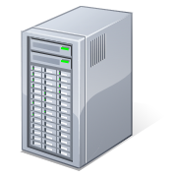

Mail routing: pre-coexistence
On-premises
MX Record:
contoso.com
Active Directory
Exchange
User Object
Mailbox-enabled
ProxyAddresses:
SMTP: John.Doe@contoso.com
Message filtering

Slide 32


Mail routing: on-premises to Office 365
On-premises
Office 365
MX Record:
contoso.com
Active Directory
Exchange
Exchange Online
Online Directory
User Object
Mail-enabled (not mailbox-enabled)
ProxyAddresses:
SMTP: John.Doe@contoso.com
TargetAddresses:
SMTP: John.Doe@contoso.mail.onmicrosoft.com
Message filtering
Exchange Online Protection
Logon Enabled User
Mailbox-enabled
ProxyAddresses:
SMTP: John.Doe@contoso.com
smtp: John.Doe@contoso.onmicrosoft.com
smtp: John.Doe@contoso.mail.onmicrosoft.com
MX Record:
contoso.onmicrosoft.com
contoso.mail.onmicrosoft.com
DirSync
DirSync Web Service

Slide 33
Mail routing: Office 365 to on-premises
On-premises
Office 365
MX Record:
contoso.com
Active Directory
Exchange
Exchange Online
Online Directory
User Object
Mailbox-enabled
ProxyAddresses:
SMTP: Jane.Doe@contoso.com
Logon Enabled User
Mail-enabled (not mailbox-enabled)
ProxyAddresses:
SMTP: Jane.Doe@contoso.com
smtp: Jane.Doe@contoso.onmicrosoft.com
smtp: Jane.Doe@contoso.mail.onmicrosoft.com
TargetAddresses:
SMTP: Jane.Doe@contoso.com
Message filtering
Exchange Online Protection
MX Record:
contoso.onmicrosoft.com
contoso.mail.onmicrosoft.com
DirSync
DirSync Web Service

Slide 34
SEM – Migration Flow
Configure Outlook Anywhere
Test using ExRCA
Assign migration
perms
Configure Directory
Sync
Wizard:
Enter server settings and admin
creds
Initial
Sync
Change MX
record
Mark migration as complete
Final
sync and cleanup
License users

Slide 35
Convert mailboxes after a SEM
Convert Exchange 2003 mailboxes to mail-enabled users after a staged Exchange migration
Convert Exchange 2007 mailboxes to mail-enabled users after a staged Exchange migration

Slide 36
Outlook.com Help
Simple Migrations
Compare Simple Migration Types
IMAP Migrations
Cutover Exchange Migrations
Staged Exchange Migrations
Tools
Exchange Remote Connectivity Analyzer
Exchange Client Network Bandwidth Calculator
PST Capture
PowerShell Scripts
Additional Resouces

Slide 37
© 2012 Microsoft Corporation. All rights reserved. Microsoft, Windows, and other product names are or may be registered trademarks and/or trademarks in the U.S. and/or other countries.
The information herein is for informational purposes only and represents the current view of Microsoft Corporation as of the date of this presentation. Because Microsoft must respond to changing market conditions, it should not be interpreted to be a commitment on the
part of Microsoft, and Microsoft cannot guarantee the accuracy of any information provided after the date of this presentation. MICROSOFT MAKES NO WARRANTIES, EXPRESS, IMPLIED OR STATUTORY, AS TO THE INFORMATION IN THIS PRESENTATION.

